Slide 1
Tesla Pump
Virtual Design Review 2
Patrick Duggan, Garrett Hart, Thomas Kline
11/09/2017
Team 12

Slide 2
Design Team
Patrick Duggan
Team Leader
Eric Goff
Secretary
Garrett Hart
Treasurer
Thomas Kline
Lead ME
Christopher Salim
Design Coordinator
Project Advisors:
James Martin
James Smith
Faculty Advisors:
Shayne McConomy, PhD
Chiang Shih, PhD
Lance Cooley, PhD

Slide 3
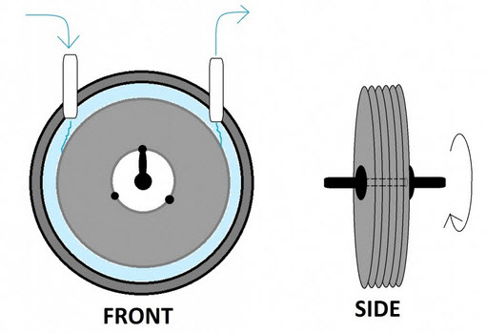
Tesla Pump Recap
Thomas Kline
Stacked Disks
Series of flat disks with inner holes that spin due to a motor
Fluid enters around center of disks and centripetally moves outward
The boundary layer effect that occurs between the disks propels the fluid
Increasing rotational speed will increase centripetal force
Figure 1. Tesla Pump System [2]

Slide 4
Tesla Pump Recap
Thomas Kline
Stacked Disks
Series of flat disks with inner holes that spin due to a motor
Fluid enters around center of disks and centripetally moves outward
The boundary layer effect that occurs between the disks propels the fluid
Increasing rotational speed will increase centripetal force
Inlet
Figure 1. Tesla Pump System [2]

Slide 5
Tesla Pump Recap
Thomas Kline
Outlet
Stacked Disks
Series of flat disks with inner holes that spin due to a motor
Fluid enters around center of disks and centripetally moves outward
The boundary layer effect that occurs between the disks propels the fluid
Increasing rotational speed will increase centripetal force
Inlet
Housing
Figure 1. Tesla Pump System [2]

Slide 6
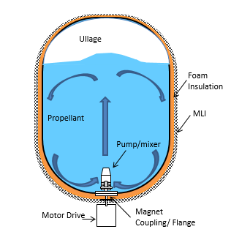
Tesla Pump Recap
Thomas Kline
Used for mixing and transporting cryogenic fluid (Liquid Nitrogen and Oxygen)
Size of tank and type of fluid defines the 15 gpm and 5 psi rise targets
Mixing will help reduce stratification within the fluid as well as disperse thermal energy
Pump shall also be robust and be able to transfer fluid from one tank to another depending on needed application
Figure 2. Propellant Mixing [3]

Slide 7
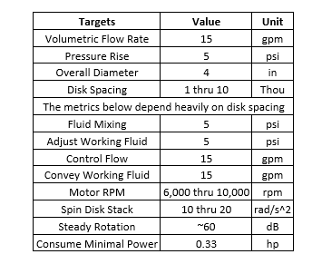
Target Catalog
Thomas Kline
Base of major targets
15 gpm
5 psi pressure rise
To reach the major targets
Disk spacing range based on previous studies
Minimal power and of disks varies based on the provided motor: Bodine 34B4BEBL
Housing dimensions
Fits on 8 in diameter conflat flange
Fits through 4 in diameter hole
Table 1. Target Catalog

Slide 8
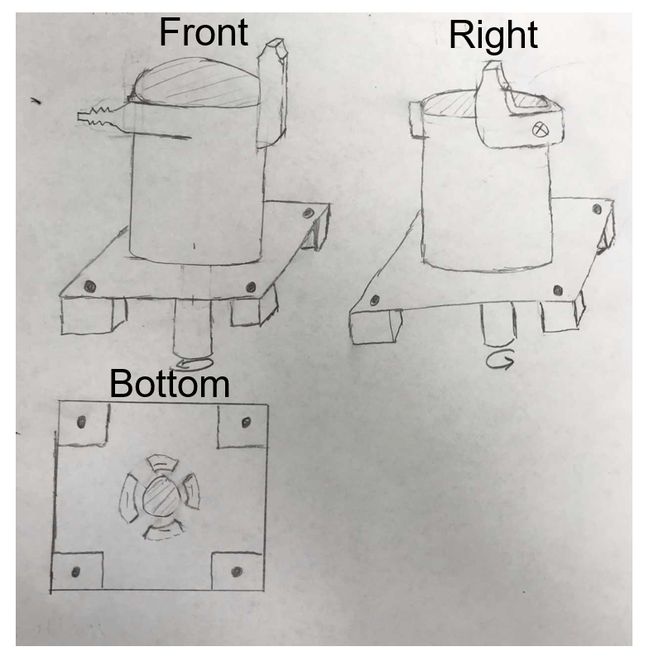
Concept Generation - Overall Concept 1
Thomas Kline
Cylindrical Housing
Anchor points at bottom
Two outlets
Mixing
Pump out
Inlets at the bottom centered around the shaft
Disks centered in housing
Figure 3. Concept 1

Slide 9
Concept Generation - Overall Concept 1
Thomas Kline
Cylindrical Housing
Anchor points at bottom
Two outlets
Mixing
Pump out
Inlets at the bottom centered around the shaft
Disks centered in housing
Figure 3. Concept 1

Slide 10
Concept Generation - Overall Concept 1
Thomas Kline
Cylindrical Housing
Anchor points at bottom
Two outlets
Mixing
Pump out
Inlets at the bottom centered around the shaft
Disks centered in housing
Figure 3. Concept 1

Slide 11
Concept Generation - Overall Concept 1
Thomas Kline
Cylindrical Housing
Anchor points at bottom
Two outlets
Mixing
Pump out
Inlets at the bottom centered around the shaft
Disks centered in housing
Figure 3. Concept 1

Slide 12
Concept Generation - Overall Concept 1
Thomas Kline
Cylindrical Housing
Anchor points at bottom
Two outlets
Mixing
Pump out
Inlets at the bottom centered around the shaft
Disks centered in housing
Figure 3. Concept 1

Slide 13
Concept Generation - Overall Concept 1
Thomas Kline
Cylindrical Housing
Anchor points at bottom
Two outlets
Mixing
Pump out
Inlets at the bottom centered around the shaft
Disks centered in housing
Figure 3. Concept 1

Slide 14
Presenting Next
Patrick Duggan
Design Concept 2 & Design Components

Slide 15
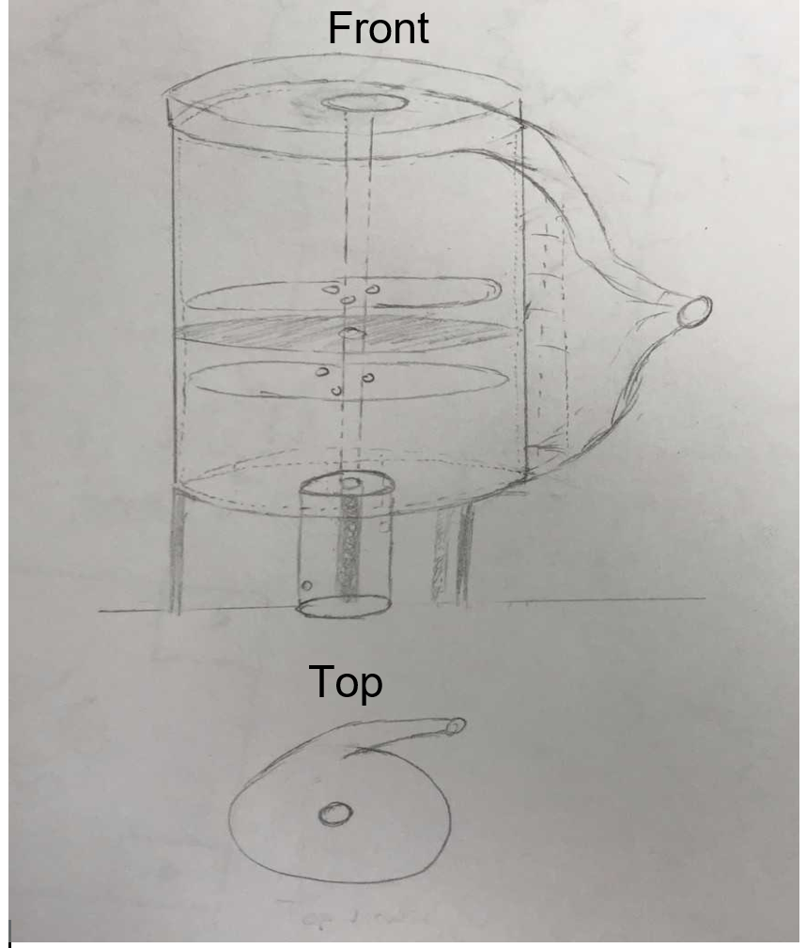
Concept Generation - Overall Concept 2
Patrick Duggan
Cylindrical divergent housing
Direct flow to outlet
Solid disk near center of disk stack
Prevent fluid from traveling farther vertically and direct it outwards
Structural support and mounting at base
Connect to flange
Figure 4. Concept 2

Slide 16
Concept Generation - Overall Concept 2
Patrick Duggan
Cylindrical divergent housing
Direct flow to outlet
Solid disk near center of disk stack
Prevent fluid from traveling farther vertically and direct it outwards
Structural support and mounting at base
Connect to flange
Figure 4. Concept 2

Slide 17
Concept Generation - Overall Concept 2
Patrick Duggan
Cylindrical divergent housing
Direct flow to outlet
Solid disk near center of disk stack
Prevent fluid from traveling farther vertically and direct it outwards
Structural support and mounting at base
Connect to flange
Figure 4. Concept 2

Slide 18
Concept Generation - Overall Concept 2
Patrick Duggan
Cantilever style bearings for shaft support
2 bearings located near base
Two inlets
Top & bottom
Permit more fluid to enter
Top inlet funneled entrance to help guide fluid
One outlet
Nipple attachment to connect hose
Figure 4. Concept 2

Slide 19
Concept Generation - Overall Concept 2
Patrick Duggan
Cantilever style bearings for shaft support
2 bearings located near base
Two inlets
Top & bottom
Permit more fluid to enter
Top inlet funneled entrance to help guide fluid
One outlet
Nipple attachment to connect hose
Figure 4. Concept 2

Slide 20
Concept Generation - Overall Concept 2
Patrick Duggan
Cantilever style bearings for shaft support
2 bearings located near base
Two inlets
Top & bottom
Permit more fluid to enter
Top inlet funneled entrance to help guide fluid
One outlet
Nipple attachment to connect hose
Figure 4. Concept 2

Slide 21
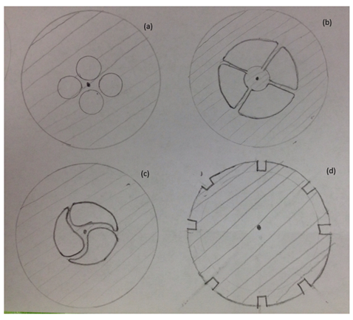
Concept Generation - Disk Hole Design
Patrick Duggan
Disk holes directly affect:
Weight of pump
Efficiency of fluid flow
Velocity of fluid
Design can include a combination of multiple hole designs
The housing intakes will also be similar to the disk holes to avoid unneeded stress build up with fluid intake
(a)
(b)
(c)
(d)
Figure 6. Disk Hole Concept

Slide 22
Concept Generation - Disk Hole Design
Patrick Duggan
The hole shapes in 6a and 6b offer a cheap and simple simple design
These designs are currently used in a wide range of applications
The teardrop shape in 6c creates a natural vortex in fluid flow pulling it down the length of the shaft
The notches in 6d allow the fluid to be easily channeled about the circumference
When staggered, the helical shape produces more torque at lower rpm
(a)
(b)
(c)
(d)
Figure 6. Disk Hole Concept
Figure 6. Disk Hole Concept

Slide 23
Concept Generation - Disk Hole Design
Patrick Duggan
The hole shapes in 6a and 6b offer a cheap and simple simple design
These designs are currently used in a wide range of applications
The teardrop shape in 6c creates a natural vortex in fluid flow pulling it down the length of the shaft
The notches in 6d allow the fluid to be easily channeled about the circumference
When staggered, the helical shape produces more torque at lower rpm
(a)
(b)
(c)
(d)
Figure 6. Disk Hole Concept
Figure 6. Disk Hole Concept

Slide 24
Concept Generation - Disk Hole Design
Patrick Duggan
The hole shapes in 6a and 6b offer a cheap and simple simple design
These designs are currently used in a wide range of applications
The teardrop shape in 6c creates a natural vortex in fluid flow pulling it down the length of the shaft
The notches in 6d allow the fluid to be easily channeled about the circumference
When staggered, the helical shape produces more torque at lower rpm
(a)
(b)
(c)
(d)
Figure 6. Disk Hole Concept
Figure 6. Disk Hole Concept

Slide 25
Concept Generation - Disk Stack
Patrick Duggan
“Variable End” Design was generated
Multiple disks are stacked together to form a “variable” disk used on the ends of the stack
The “Variable End” ensures disk spacing can be controlled while keeping overall length constant
For further control the spacers and disks themselves can be made thinner
Ending Disk Stack | Spacers | Disks
Figure 7. Disk Stack Concept

Slide 26
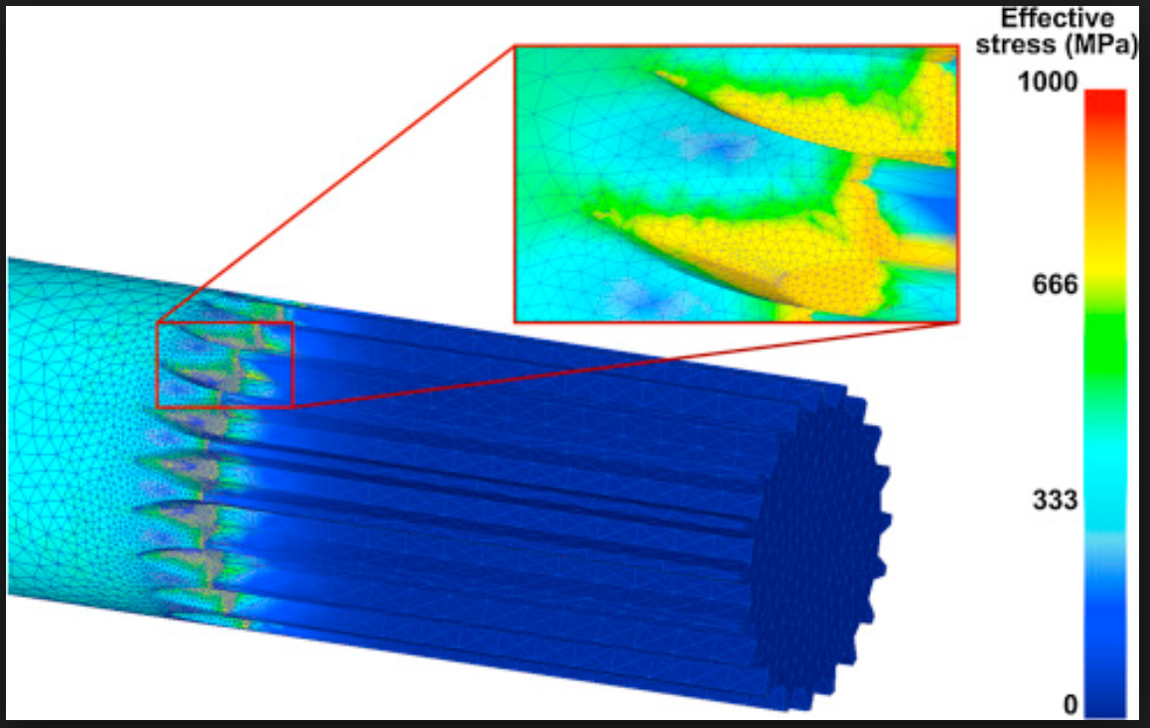
Concept Generation - Disk Shaft
Patrick Duggan
Need to:
Prevent excessive vibration
Asymmetric vs. Symmetric
Rigidly attach disks to shaft
Internal vs. External teeth attachment style
Location of stress concentrations
Permit variation of disk spacing
Feasibility of design
Can it be manufactured or purchased at a reasonable cost?
Figure 8. Shaft Concepts
Stress (Mpa)
Figure 9. Effective Stress Along a Shaft [3]

Slide 27
Presenting Next
Garrett Hart
Design Components & Conclusion

Slide 28
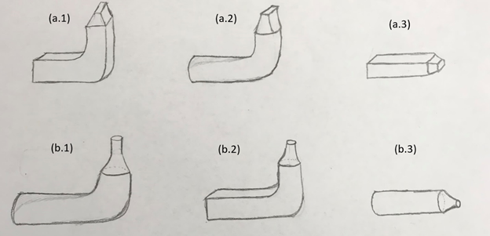
Concept Generation - Outlet Nozzle
Garrett Hart
Figure 10. a-series
Rectangular cross sectional area nozzle
(a.1)Rectangular tube 90° bend
(a.2)Round tube smooth 90° bend
(a.3)Rectangular tube straight out horizontally
Figure 10. b-series
Round cross sectional area
(b.1)Round tube smooth 90° bend
(b.2)Rectangular tube 90° bend
(b.3)Round tube straight out horizontally
Figure 10. Outlet Nozzle Concepts

Slide 29
Concept Generation - Outlet Nozzle
Garrett Hart
Figure 10. a-series
Rectangular cross sectional area nozzle
(a.1)Rectangular tube 90° bend
(a.2)Round tube smooth 90° bend
(a.3)Rectangular tube straight out horizontally
Figure 10. b-series
Round cross sectional area nozzle
(b.1)Round tube smooth 90° bend
(b.2)Rectangular tube 90° bend
(b.3)Round tube straight out horizontally
Figure 10-a.1. Outlet Nozzle (a.1) Concept

Slide 30
Concept Generation - Outlet Nozzle
Garrett Hart
Figure 10. a-series
Rectangular cross sectional area nozzle
(a.1)Rectangular tube 90° bend
(a.2)Round tube smooth 90° bend
(a.3)Rectangular tube straight out horizontally
Figure 10. b-series
Round cross sectional area nozzle
(b.1)Round tube smooth 90° bend
(b.2)Rectangular tube 90° bend
(b.3)Round tube straight out horizontally
Figure 10-a.2. Outlet Nozzle (a.2) Concept

Slide 31
Concept Generation - Outlet Nozzle
Garrett Hart
Figure 10. a-series
Rectangular cross sectional area nozzle
(a.1)Rectangular tube 90° bend
(a.2)Round tube smooth 90° bend
(a.3)Rectangular tube straight out horizontally
Figure 10. b-series
Round cross sectional area nozzle
(b.1)Round tube smooth 90° bend
(b.2)Rectangular tube 90° bend
(b.3)Round tube straight out horizontally
Figure 10-a.3. Outlet Nozzle (a.3) Concept

Slide 32
Concept Generation - Outlet Nozzle
Garrett Hart
Figure 10. a-series
Rectangular cross sectional area nozzle
(a.1)Rectangular tube 90° bend
(a.2)Round tube smooth 90° bend
(a.3)Rectangular tube straight out horizontally
Figure 10. b-series
Round cross sectional area nozzle
(b.1)Round tube smooth 90° bend
(b.2)Rectangular tube 90° bend
(b.3)Round tube straight out horizontally
Figure 10-b.1. Outlet Nozzle (b.1) Concept

Slide 33
Concept Generation - Outlet Nozzle
Garrett Hart
Figure 10. a-series
Rectangular cross sectional area nozzle
(a.1)Rectangular tube 90° bend
(a.2)Round tube smooth 90° bend
(a.3)Rectangular tube straight out horizontally
Figure 10. b-series
Round cross sectional area nozzle
(b.1)Round tube smooth 90° bend
(b.2)Rectangular tube 90° bend
(b.3)Round tube straight out horizontally
Figure 10-b.2. Outlet Nozzle (b.2) Concept

Slide 34
Concept Generation - Outlet Nozzle
Garrett Hart
Figure 10. a-series
Rectangular cross sectional area nozzle
(a.1)Rectangular tube 90° bend
(a.2)Round tube smooth 90° bend
(a.3)Rectangular tube straight out horizontally
Figure 10. b-series
Round cross sectional area nozzle
(b.1)Round tube smooth 90° bend
(b.2)Rectangular tube 90° bend
(b.3)Round tube straight out horizontally
Figure 10-b3. Outlet Nozzle (b.3) Concept

Slide 35
Concept Generation - Outlet Nozzle
Garrett Hart
Figure (10-a) a-series
Rectangular cross sectional area nozzle
Pros
Promotes better fluid mixing
Cons
Cost more to produce
Better fluid mixing = less pressure rise
Figure 10-a. Rectangular Outlet Concept

Slide 36
Concept Generation - Outlet Nozzle
Garrett Hart
Figure(10-b) b-series
Round cross sectional area nozzle
Pros
Generates great fluid Pressure rise
Easiest to process
Cheaply made
Cons
High pressure rise = less efficient
fluid mixing
Figure 10-b. Round Nozzle Concept

Slide 37
Concept Generation - Outlet Nozzle
Garrett Hart
Figure 11. Jet Velocity Gradient [1]

Slide 38
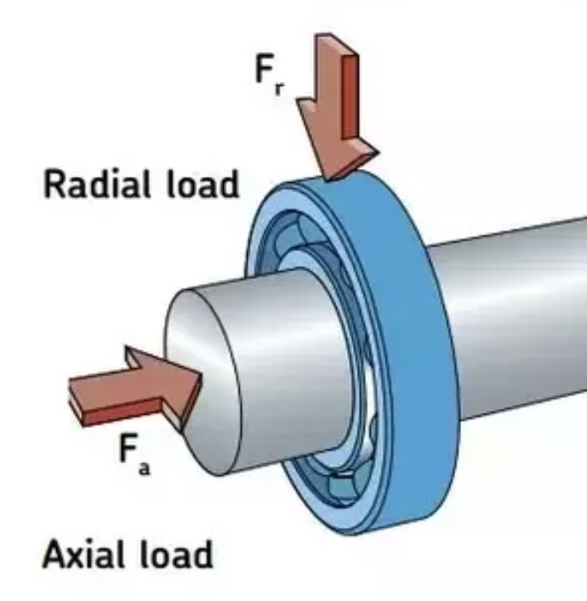
Concept Generation - Bearings
Garrett Hart
Axial loads are located along the shaft
Radial loads are located perpendicular to the shaft
Figure 12: Bearing Load distribution [4]

Slide 39
Concept Generation - Bearings
Garrett Hart
Axial loads are located along the shaft
Radial loads are located perpendicular to the shaft
Figure 12: Bearing Load distribution [4]

Slide 40
Concept Generation - Bearings
Garrett Hart
Axial loads are located along the shaft
Radial loads are located perpendicular to the shaft
Figure 12: Bearing Load distribution [4]

Slide 41
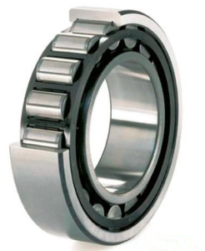
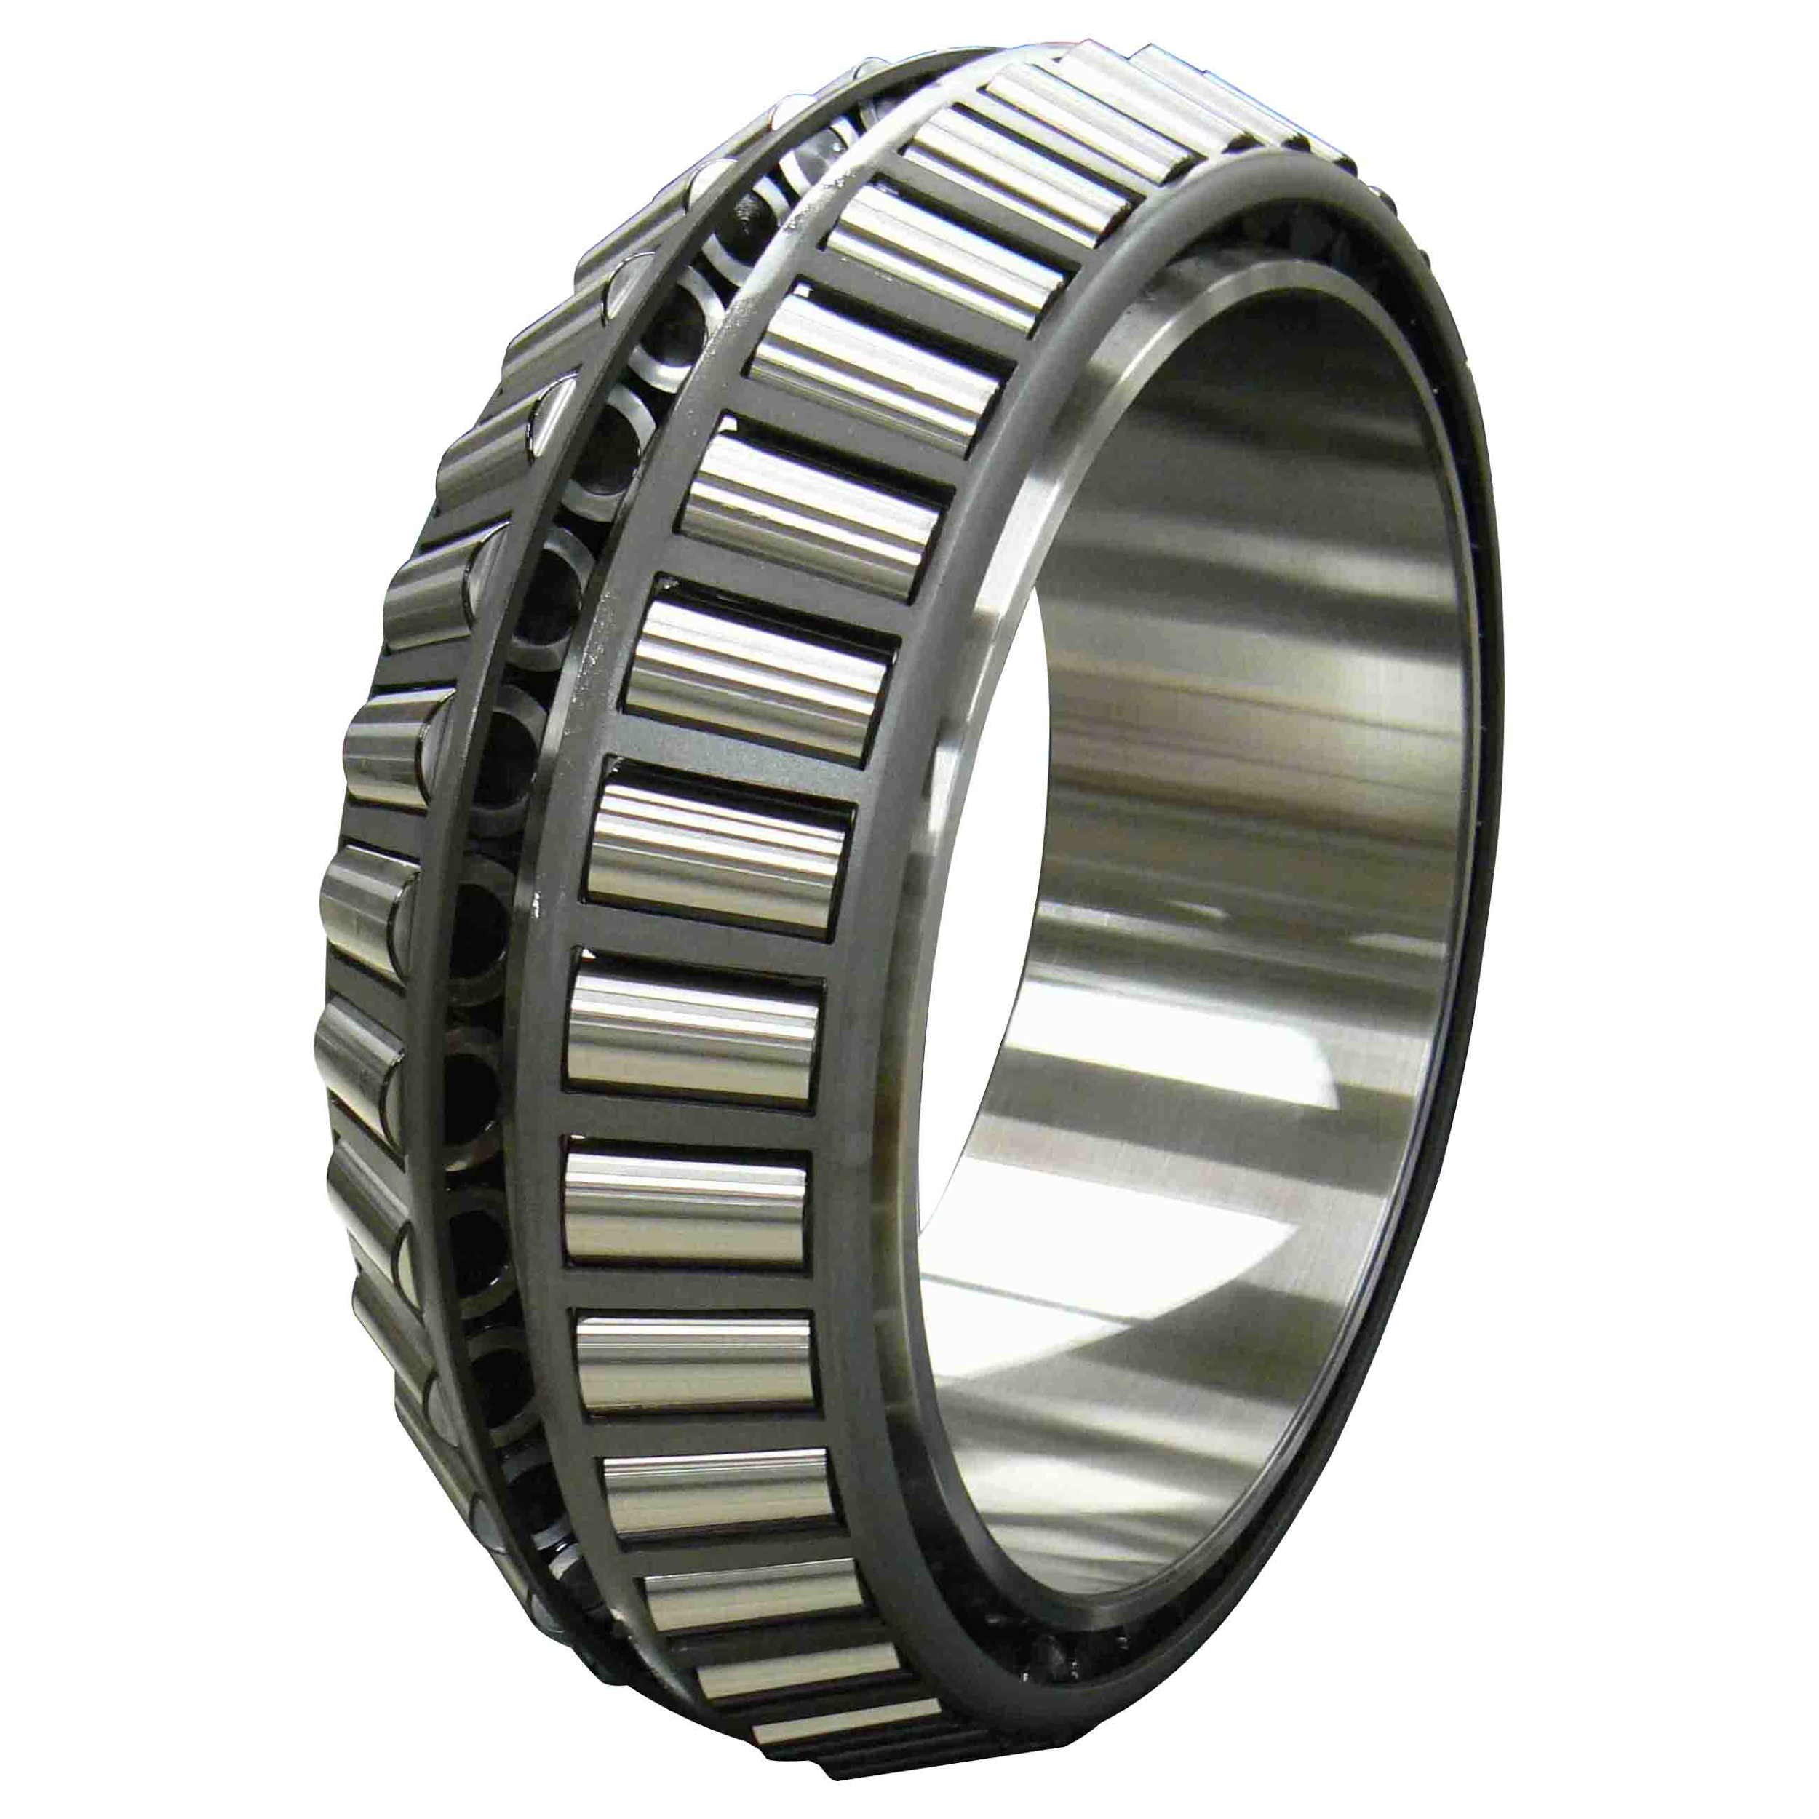
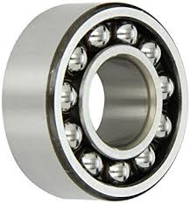
Concept Generation - Bearings
Garrett Hart
Figure 13-a. Straight Roller Bearing [3]
Sacrifices axial loads for radial loads
Cylindrical shape spreads out radial stress concentration
Figure 13-b.Tapered Roller Bearing [3]
Better at balancing a combination of axial and radial loads
Figure 13-c. Ball Bearing [3]
Cheapest and easiest to acquire.
Can be prone to deformation

Slide 42
Concept Generation - Bearings
Garrett Hart
Figure 13-a. Straight Roller Bearing [5]
Sacrifices axial loads for radial loads
Cylindrical shape spreads out radial stress concentration
Figure 13-b.Tapered Roller Bearing [5]
Better at balancing a combination of axial and radial loads
Figure 13-c. Ball Bearing [5]
Cheapest and easiest to acquire.
Can be prone to deformation

Slide 43
Concept Generation - Bearings
Garrett Hart
Figure 13-a. Straight Roller Bearing [3]
Sacrifices axial loads for radial loads
Cylindrical shape spreads out radial stress concentration
Figure 13-b.Tapered Roller Bearing [3]
Better at balancing a combination of axial and radial loads
Figure 13-c. Ball Bearing [3]
Cheapest and easiest to acquire.
Can be prone to deformation

Slide 44
Questions ?

Slide 45
References
[1] Dr. Guha, Tufan. “Rectanguar Jet_Lecture Notes.” Thermal Fluids Class. Thermal Fluids Class, Tallahassee, FAMU- FSU College of Engineering.
[2] “Tesla Turbine.” TurbineGenerator, TurbineGernerator, 20 Dec. 2016,
turbinegenerator.org/tesla-turbine/.
[3]“What Is Radial Load and Axial Load?” Quora, Kaydon Bearing Solutions, www.quora.com/What-is-radial-load-and-axial-load.
[4]“Failure Analysis of a Half-Shaft of a Formula SAE Racing Car.” Case Studies in Engineering Failure Analysis, Elsevier, 9 May 2016, www.sciencedirect.com/science/article/pii/S2213290216300086.
[5] “Bearings.” Motion Industries, Motion Industries, www.motionindustries.com/taxonomy/Bearings/browse/en.
Notes:
https://www.ksb.com/centrifugal-pump-lexicon/noise-in-pumps-and-systems/191140/

